Slide 1
Data Lake Versioning - Explained
Oz Katz, September 2020

Slide 2
Agenda
Use cases for data versioning
Intro to lakeFS
Versioned data formats compared: Delta, Hudi, Iceberg
Example: Using Delta + lakeFS to build a resilient data pipeline

Slide 3
Use cases for data versioning
Collaboration
ML Pipelines
Mutability & Concurrency Control
Data Lifecycle Management

Slide 4



Data versioning - Collaboration

Slide 5



Data versioning - ML Pipeline Management

Slide 6



Data versioning - Mutability & Concurrency Control

Slide 7

Data versioning - Data Lifecycle Management

Slide 8
Introducing lakeFS

Slide 9

In a perfect world
Atomic, versioned data lake on top of object storage

Slide 10
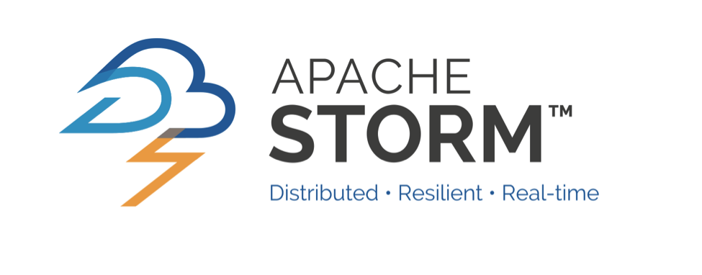





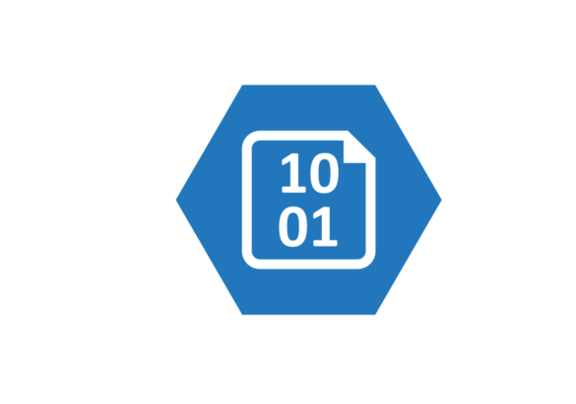





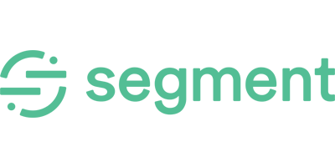

Intro to lakeFS
Data Sources
Data Consumption
Object Store

Slide 11
s3://data-bucket/collections/foo
s3://data-bucket/master/collections/foo

Slide 12
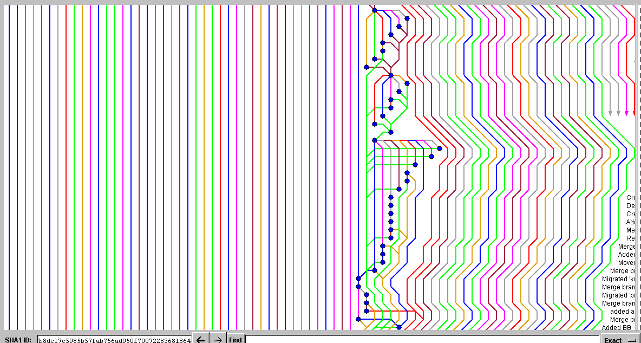
How do we branch data?

Slide 13
Dev Env. for Data
Experiment - try tools and code in isolation
Compare - tools, code or different versions of your data
Reproduce - go back to any point of time for both your code and your data

Slide 14
Data branching models - Experiment
Revert
experiment-1
Master

Slide 15
Data branching models - Compare
experiment-2
diff
experiment-1
diff
Master

Slide 16
Data branching models - Reproduce
Commit metadata
job_git_commit = 60cf3d
Repro-1
Master

Slide 17
Continuous Integration
Ingest new data safely
Enforce best practices
Metadata validation - prevent breaking changes from entering your production data environment

Slide 18
Data branching models - Enforce Best Practices
master pre-merge hooks:
No user_* columns except under /private/...
Only (*.parquet | *.orc | _delta_log/*.json) files allowed
Under /production, only backwards-compatible schema changes are allowed
New tables on master must be registered in our metadata repository first, with owner and SLA

Slide 19
Data branching models - Enforce Best Practices
merge changeset:
✓ 001.parquet
✓ 002.parquet
𐄂 random.csv
new-data-1
𐄂
master

Slide 20
Continuous Deployment
Instantly revert changes to data
Enforce cross collection consistency
Prevent data quality issues by easily enabling
Testing production data before exposing it to users / consumers
Testing intermediate results in your DAG to avoid cascading quality issues

Slide 21
Data branching models - Rollback
Commit metadata
topic_name = events
topic_offset = 1761348
job_git_commit = 60c3fa
Stream-1
Master

Slide 22
Data branching models - Data Quality
SELECT SUM(...)
-- compared to last week
events-data
𐄂
master

Slide 23
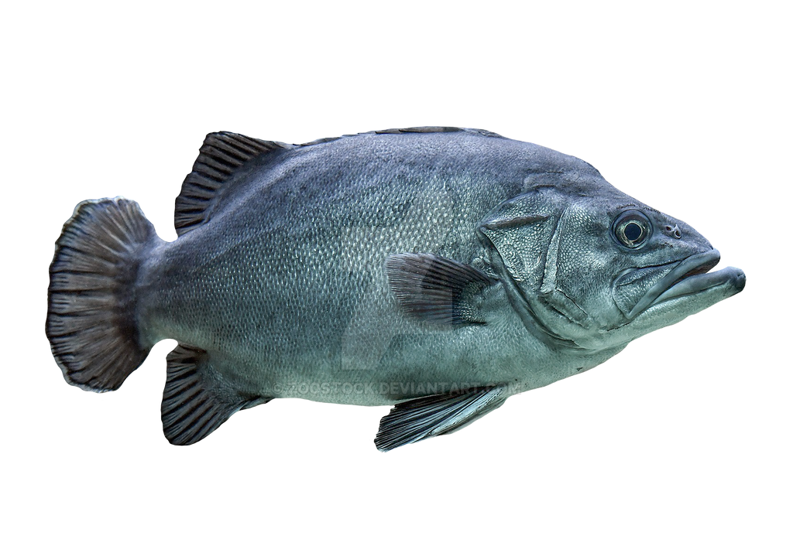
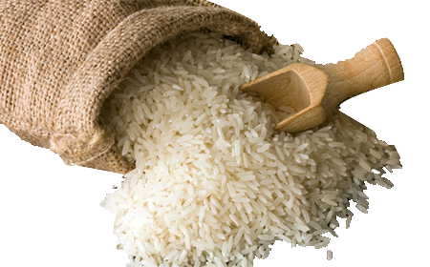

Data branching models - Cross Collection Consistency
sales-stream
contains both sales and marketing
daily data
marketing-stream
leads-daily
master

Slide 24
Versioned Data Formats Compared

Slide 25
Versioned data formats - Compared

Slide 26

Versioned data formats - Compared

Slide 27
Versioned data formats - Compared

Slide 28
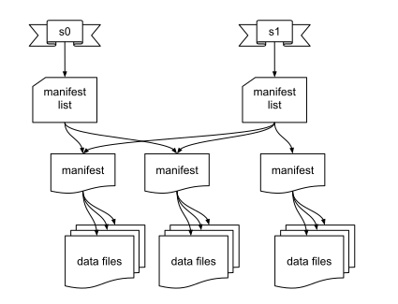
Versioned data formats - Compared
A table format
Decouple from storage capabilities
Arbitrary partitioning
Atomic metadata operations
Concurrency control → Snapshot Isolation → time travel

Slide 29
Versioned Data Formats Compared

Slide 30
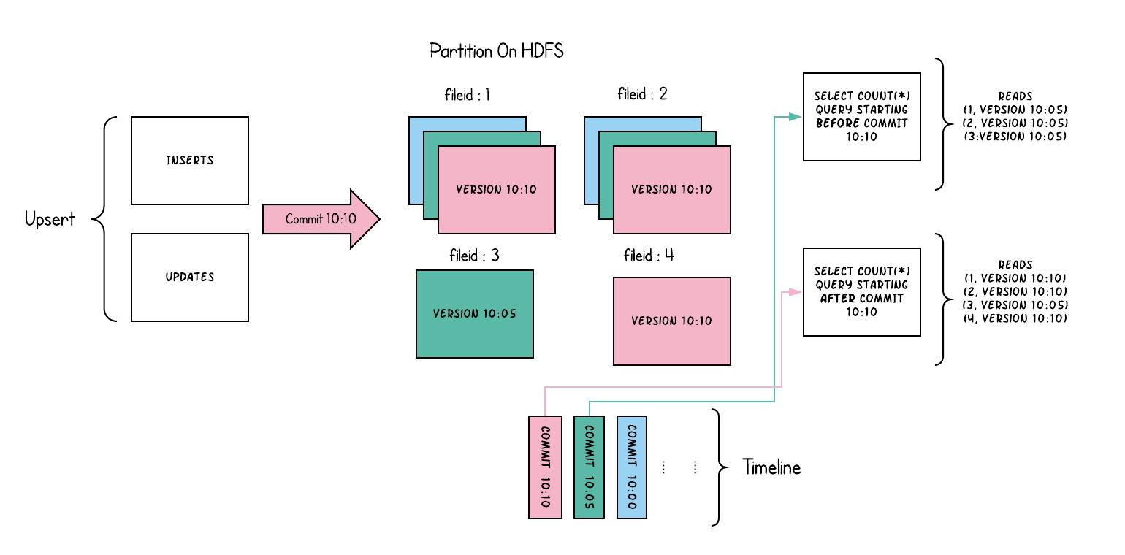
Versioned data formats - Compared
A table format
Made for upserts and deletes
CoW vs MoR
Concurrency control → Snapshot Isolation via timeline → time travel
AWS seems to like it
(maybe because they compete with DataBricks)

Slide 31
Versioned data formats - Compared

Slide 32
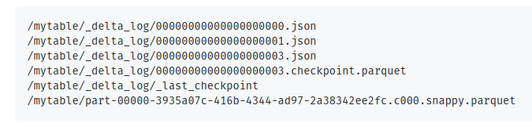
Versioned data formats - Compared
A table storage format
Made for upserts and deletes
Concurrency control → Snapshot Isolation via timeline → time travel
DataBricks seems to like it
(maybe because they compete with AWS)

Slide 33
Example:
Using Delta with lakeFS to build a resilient data pipeline

Slide 34

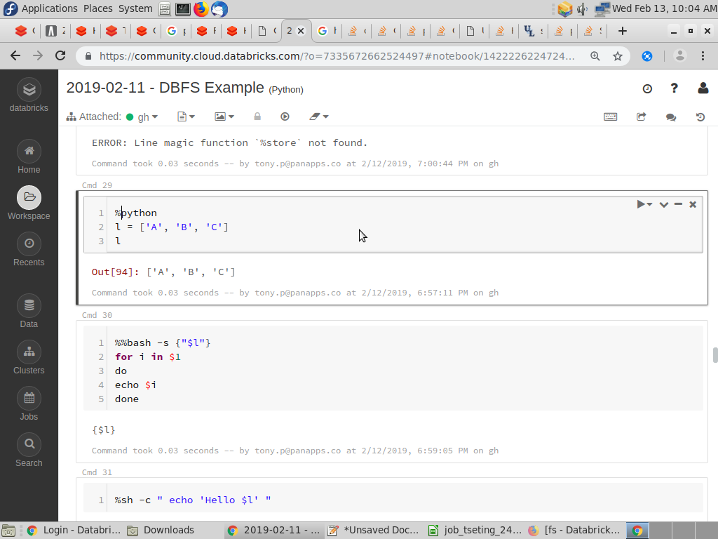


The problem
SELECT SUM(price)
FROM sales;
Subscriber #1
Spark Writer
sales/by_date
?
changeset
Subscriber #2
Spark Writer
sales/by_country

Slide 35
With lakeFS
SELECT SUM(price)
FROM sales;
Subscriber #1
Spark Writer
sales/by_date
sales/by_date
changeset
Subscriber #2
Spark Writer
sales/by_country
sales/by_country
Branch: sales-live
Branch: master

Slide 36

With lakeFS
pre-merge Hook
SELECT SUM(price)
FROM sales;
Subscriber #1
Spark Writer
sales/by_date
sales/by_date
changeset
Subscriber #2
Spark Writer
sales/by_country
sales/by_country
Branch: sales-live
Branch: master

Slide 37
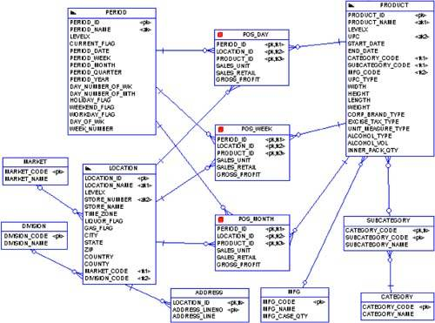
With lakeFS
SELECT a.f1, a.f2, b.f3, c.f4
FROM table1 a
INNER JOIN table2 ON …
INNER JOIN table3 ON …
INNER JOIN table4 ON …
INNER JOIN table5 ON …
But, you know, as it was last week.
Branch: master
Commit: last week’s

Slide 38




Questions & Resources
Getting started
Check out the docs
Join the lakeFS Slack Channel
Contribute and star the repo

Slide 39
Join the community
GitHub
oz.katz@treeverse.io

